Slide 1
DRAW Drug Review Analysis Work

Slide 2
What Inspires us
We can get easily overwhelmed by numerous online reviews listed for medicines available for any conditions
Due to various limitations in clinical trials, adverse side effects may not be detected before the drug is launched in the market
Text analysis on drug reviews could be useful for patients, pharmacy companies and doctors to improve consumer safety by assisting in the reduction of medication errors
There is no tool available in the market to suffice these issues. Therefore, we will create a web application where patients and doctors can search by symptoms and get drug recommendations, side effects of drugs and obtain insights into patients’ portfolio.

Slide 3
Problem Statement
We aim to answer the following questions through our platform:
How to use sentiment analysis on reviews and recommend the most effective drugs for the given condition?
To know the side effects and exact polarity of drug reviews to help pharmacy companies take required action to improve the drug
Help doctors and pharma identify the age group and gender of target audience for a chosen drug
Provide consolidated information for side effects, emotional inclination towards drugs and classification of drug reviews

Slide 4
Methodology
RAW DATA
PROCESSED DATA
Entity Resolution +
Fuzzy Matching
Drug Review
+
NLTK Vader
Review + Rating
+
LSTM
Real time review
+
Deep NN (Sequential Model)
Review
+
NRC Emotion Lexicon
Uniform Patient Conditions
Sentiment
Analysis
Rating
Prediction
Sentiment Classification
Emotion
Classification
Drug Recommendation based on Condition

Slide 5







Data Sources and Collection
SCRAPPED DATA
Filtering
Wrangling
PostgreSQL Database
Pre-Processing

Slide 6








Data Science Pipeline
Data Collection
Scrapped drugs data from WebMD and DrugLib using Beautiful soup and Scrapy and collected Drugs.com data from Kaggle
Data Cleaning
Used Entity Resolution (Jaccard Similarity) and Fuzzy Matching to create uniform patient conditions, filtered data and performed data grouping(age)
Preprocessing & EDA
Visualized most common drugs, conditions, rating distribution, sentiment score vs rating and review useful count vs rating
Data Aggregation
Aggregated matching drugs and condition from 3 websites into one dataset, removing large scale shifts
Feature Engineering
Quantify review words using Bag of Words models like TF-IDF, Hashing vectorizer and normalized sentiment rating to review rating scale
Used user review to predict rating and classify sentiment using ML models (LR, RF, XGBoost, SVM) & Deep Learning models (LSTM, GRU, Sequential)
Predictive Modelling
Model Selection
Selected the best model using multiple criteria like confusion matrix, model accuracy, early stopping, model checkpoint & classification report
Interactive webapp using Plotly and Dash, built Drug Recommendation System, implemented real time sentiment classification, rating vs age distribution, emotion analysis of reviews, TSNE plots (reviews, side effects), and side effects wordcloud
Web Application

Slide 7
Why this solution?
There is no tool available in the market which provides consolidated information at a single place regarding medicines available for any conditions
A unique solution for drug recommendation as well as awareness about side effects
Sentiment analysis can be used by drug makers to obtain valuable patient opinion
Instant online help about medications and symptoms.
Correctness of our results
Sentiment analysis alone is not sufficient to provide correct review analysis. Therefore, we have used multiple predictive model results to accurately provide recommendation.
Our webapp performs precise classification of emotions and side effects identification, which will not only help patients to self categorize but also pharma industry to inherit patient feedback

Slide 8
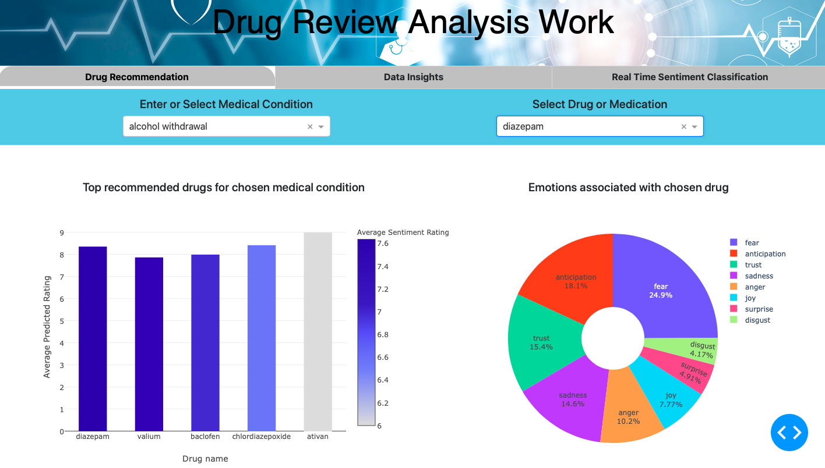
Data Product
Web app (http://127.0.0.1:8050)

Slide 9
Learnings
Developed various web scraping scripts: Scrapy (Spider), Beautiful Soup for data acquisition
PostgreSQL: Storage and retrieval of data
Text mining using NLP (Stopwords Removal, Tokenizing, Stemming)
Sentiment and Emotion classification using NLTK libraries
Training different ML and Deep Learning models and their deployment for real time analysis
Web data visualization tools (Plotly, Dash, Wordclouds, Confusion Matrix, Bar Polar charts, t-SNE plots)
App deployment on Heroku

Slide 10
Future Work
A lot of information like cost, dosage, duration of condition and past medical history are hidden under reviews. We can build a robust Text Mining system to make personalized recommendations to users and provide in-depth analysis to pharmacies.
Healthcare Chatbot
Online assistance/recommendation based on patient symptoms
Monitor emotional heath of patients through conversations
Connecting to a medical information platform through API for real time data and visualizations
Add a scheduled retraining of models to website for incorporating latest changes

Slide 11
Team: Data Pirates
Akash Singh Kunwar: 301401851
Rohan Harode: 301406504
Shubham Malik: 301403562

Slide 12


